Slide 1
Chapter Two Basic Router and switch configuration

Slide 2
Integrated Services Routers
The Cisco Integrated Services Router (ISR) is one of the most popular series of networking devices designed to support growing business needs.
The ISR combines features such as routing and switching functions, security, voice, LAN and WAN connectivity into a single device.
This makes the ISR ideal for small to medium-sized businesses and for ISP managed customers.

Slide 3
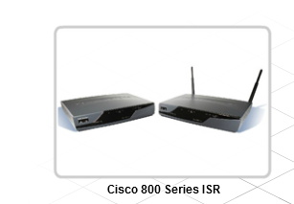
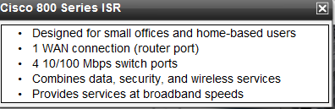
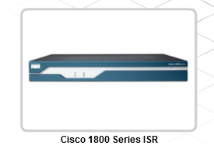
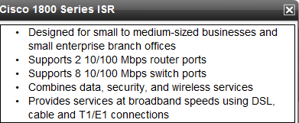
Cont…

Slide 4
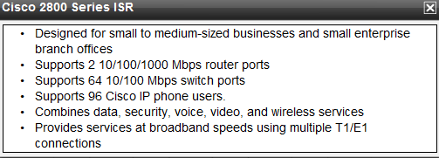
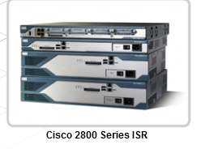
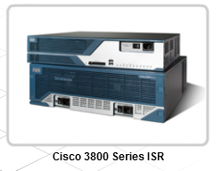
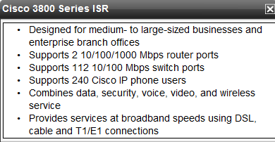
Cont…

Slide 5
Router configuration
Items shipped with a new purchased Router include:
A RJ45-to-DB9 console cable
A DB-9-to-DB-25 modem adapter
A power cable
Product registration card
Regulatory Compliance and Safety Information for Routers
Router and Security Device Manager (SDM) Quick Start Guide
Routers (Modular) Quick Start Guide

Slide 6
Cont…
Typically, the tools required to install a new device include:
PC with a terminal emulation program, such as HyperTerminal
Cable ties and a No 2 Phillips screwdriver.
Cables for WAN interfaces, LAN interfaces, and USB interfaces

Slide 7
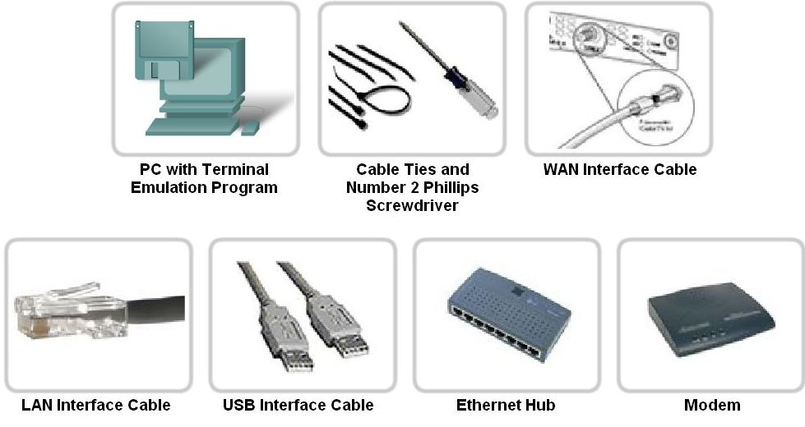
Cont…

Slide 8
Cont….
Follow these steps to perform a power up procedure on Router:
1. Securely mount and ground the device chassis, or case.
2. Seat the external compact flash card.
3. Connect the power cable.
4. Configure terminal emulating software on the PC and connect the PC to the console port.
5. Turn on the router.
6. Observe the start-up messages on the PC to check for any errors.

Slide 9
Router configuration Components
IOS Software
The Internetwork Operating System (IOS) software provides features that enable a device to send and receive network traffic using a wired or wireless network.
NVRAM
A none volatile memory that store startup configuration.
RAM
Used to store running configuration.

Slide 10
Cont…
Flash
Used to store IOS file
port
Console port:-Used to connect router with computer
AUX:-used to connect router with modem
Interface
Used to connect router with other device
Ethernet/Fast Ethernet :-used for LAN
Serial:-used for WAN
Loopback:- virtual interface used to simulate the network.

Slide 11
Command Line Interface
The IOS CLI is a text-based program that enables the entering and executing of IOS commands to configure, monitor, and maintain Cisco devices.
In addition to the IOS CLI, other tools are available to assist in configuring a router.
Security Device Manager (SDM) is a graphical user interface (GUI) device management tool.
SDM simplifies initial router configuration.
It uses a step-by-step approach to create a basic router configuration quickly and easily.

Slide 12
Device Configuration Files
Running Configuration File
The term running configuration refers to the current configuration running on the device.
The running configuration is stored within the device working memory(RAM).
The running configuration is lost each time the device is shut down unless the running configuration is saved to the startup configuration file.

Slide 13
Cont…
Startup Configuration File
The startup configuration file is the saved configuration file.
This file is stored in nonvolatile random access memory (NVRAM).
CLI Command Modes
The command-line interface: user EXEC access , privileged EXEC access and Global mode.
When a router is powered on, the access level defaults to user access.
User mode is indicated by a command-line prompt: Router>

Slide 14
Cont…
To enter commands that can alter the operation of the device requires privileged level access.
Enable the privileged EXEC mode by entering enable at the command prompt and pressing Enter.
The prompt for the privileged mode is Router#.
To disable the privileged mode and return the device to user mode, enter disable or exit at the command prompt.
Both the user EXEC mode and the privileged EXEC mode can be protected with a password.

Slide 15
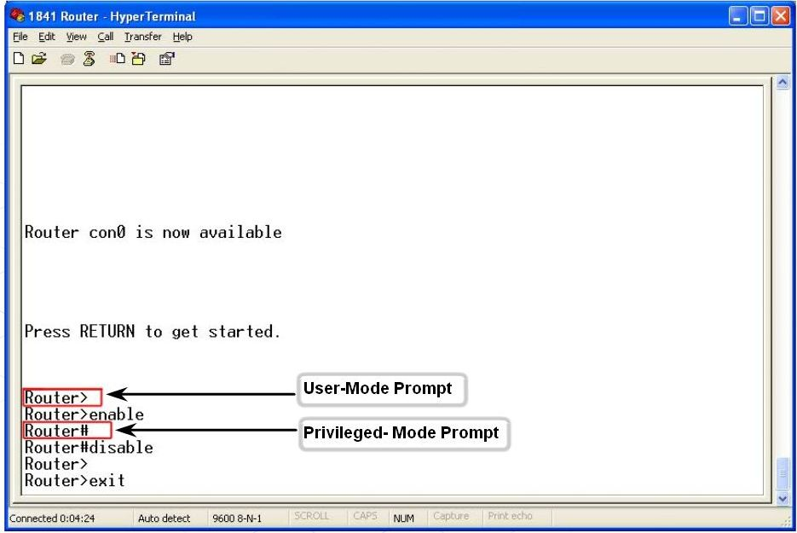
Cont…

Slide 16
Cont…
The privileged mode grants access to the various configuration modes used to set up the device.
In most cases, commands will be configured to the running configuration file from the terminal.
To access these commands, the user must enter global configuration mode.
To enter global configuration, type the command: configure terminal or config t.

Slide 17
Cont…
Global configuration mode is indicated by the command line prompt Router(config)#.
Any commands entered in this mode will take effect immediately and can alter the operation of the device.
globale.docx

Slide 18
Cont…
Users will sometimes make a mistake when typing a command.
CLI provides output indicating an unrecognized or incomplete command.
The % symbol indicates error marker messages.
For example, if the command interface is entered with no other parameters, the output shows that it is an incomplete command (% Incomplete command.).
Use the ? to see additional parameters.
If an incorrect command is entered, the error message would read: %Invalid input detected.

Slide 19
Cont…
Fortunately, the CLI provides error isolation in the form of an error indicator, a caret symbol (^).
The ^ symbol appears at the point in the command string where there is an incorrect or unrecognized character.
This enables the user to return to the point where the error was made and use the help function to determine the correct command to use.
error.docx

Slide 20
Basic configuration
Show command
Show command used to display configuration information.
This command implement in privilege mode.
show running-config
Show startup-config
show interfaces
show ip route
show version
Show flash

Slide 21
Cont…
To copy the changes made to the running configuration back to the stored startup configuration file, use the command:
Router#copy run start
A device should be given a unique name to change router name you have to enter into global configuration mode with the following command:
Router(config)#hostname [name]

Slide 22
Cont…
The enable password and enable secret commands are used to restrict access to the privileged EXEC mode.
The following commands are used to set the passwords:
Router(config)#enable password [password ]
Router(config)#enable secret [password ]
The enable password command is not encrypted by default.
If the enable password is set, followed by the enable secret, the enable secret will override the enable password.

Slide 23
Cont…
There are multiple ways to access a device to perform configuration tasks.
One of these ways is to use a PC attached to the console port on the device.
To set the password for console connection access, first enter the global configuration mode.
Once there, use the following command:
Router(config)#line console 0
Router(config-line)#password [password]
Router(config-line)#login
This will prevent unauthorized users from accessing user mode from the console port.

Slide 24
Cont…
When the device is accessed through the network, it is considered a virtual terminal connection.
The password must be configured on the virtual port.
Router(config)#line vty 0 4
Router(config-line)#password [password]
Router(config-line)#login
It used to protect router to be accesses by unitized user from remote.

Slide 25
Cont…
The console password are visible to users and to secure it should be encrypted.
The command service password encryption will ensure that passwords are encrypted.
Router(config)# service password-encryption
In order for a router to direct traffic from one network to another, the interfaces on the router are configured to participate in each of the networks.
A router interface connects to a network and has an IP address and subnet mask assigned to it.

Slide 26
Interface Configuration
There are many different types of interfaces available.
Serial and
Ethernet interfaces are the most common.
Local network connections use Ethernet interfaces.
WAN connections require the use of a serial connection.
Unlike Ethernet interfaces, serial interfaces require a clock signal to control the timing of the communications, this is known as a clock rate.

Slide 27
Cont…
In most environments, Data Communications Equipment (DCE) devices such as a modem, provides the clock rate.
By default, Cisco routers are DTE devices, or Data Terminal equipment, This means that they accept the clock rate from the DCE device.
If the router is connected as the DCE device, a clock rate must be set on the router interface to control the timing of the DCE/DTE connection.

Slide 28
Cont…
To configure any interface on the router, it is necessary to be in the global configuration mode.
The steps to configure an interface include:
1. Specify the type of interface and the interface port number
2. Configure the interface IP address and subnet mask
3. Set the clock rate, if configuring a serial interface as a DCE
4. Enable the interface

Slide 29
Cont…
Router(config)# intrface se0/0/0
Router(config)# ip address 192.168.10.1 255.255.255.0
Router(config)# Clock rate 56000
Router(config)# No shutdown

Slide 30
Stand Alone Switches
As customer networks grow, it is often necessary to add larger, more capable switches to support additional users.
A switch is a device that is able to direct a stream of messages coming in one port, out of another port based on the destination MAC address within the frame.
A switch cannot route traffic between two different local networks.
In the context of the OSI model, a switch performs the Layer 2, known as the data-link layer function.
There are several models of Ethernet switches available depending on user requirements.
The Cisco Catalyst 2960 Series Ethernet switch is designed for medium-sized, and branch office networks.
They are designed to provide 10/100 Fast Ethernet and 10/100/1000 Gigabit Ethernet connectivity to desktop computers.
The 2960 series Ethernet switches use Cisco IOS software and can be configured using the GUI-based Cisco Network Assistant or through the CLI.

Slide 31
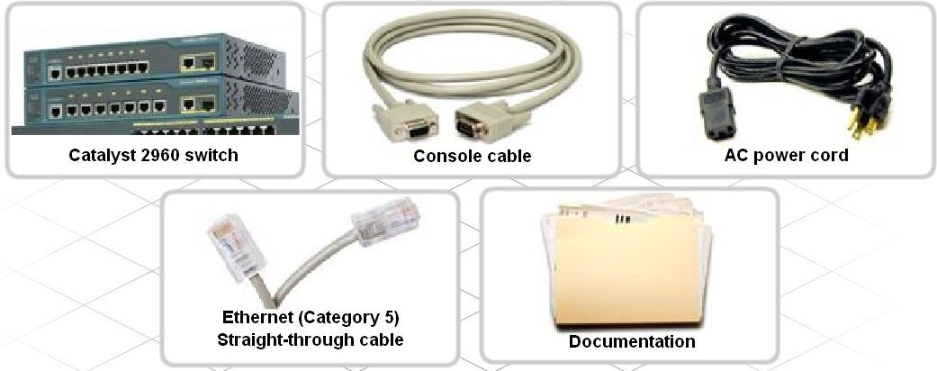
Initial Cisco 2960 Switch Configuration
Perform basic physical set up of a stand-alone LAN switch

Slide 32
Cont…
Each switch port can operate in either half-duplex or full-duplex mode.
When a port is in half-duplex mode, at any given time, it can either send or receive data but not both.
When a port is in full-duplex mode, it can simultaneously send and receive data.
Both the port and the connected device must be set to the same duplex mode.
If they are not the same, this creates a duplex mismatch and can lead to excessive collisions and degrade communication.

Slide 33
Cont…
Switch ports can have the speed and duplex set manually or can use auto negotiation.
Auto negotiation occurs when the port can auto-detect the speed and duplex of the device that is connected to the port.
Auto negotiation is enabled by default on many Cisco switches.
For auto negotiation to be successful, both connected devices must support it.
If the switch is in auto negotiation mode and the connected device does not support it, the switch will:
Use the speed of the other device (10, 100, 1000)
Default to half-duplex mode
This can create issues if the non-auto-negotiating device is set to full duplex mode, because the switch defaults to half-duplex.

Slide 34
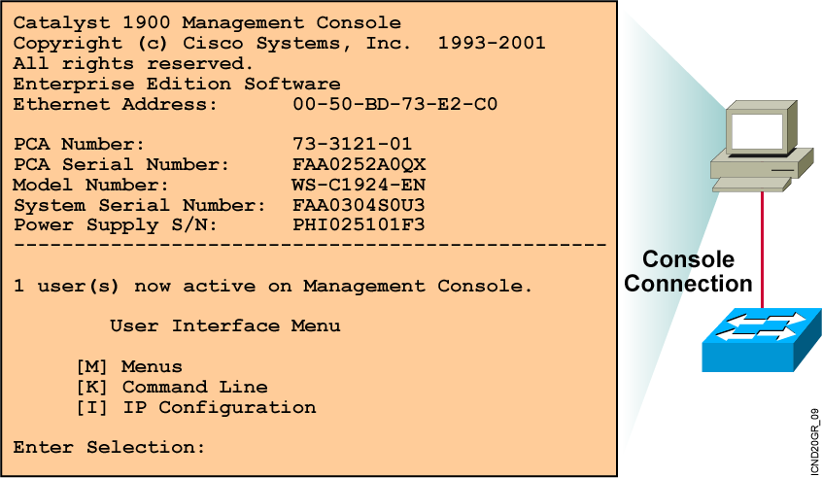
Initial Boot up Output from the Catalyst 1900 Switch
Notes:
Purpose: This slide describes the console output on the Catalyst 1900 switch during startup.
Emphasize: If a POST fails, a corresponding console message will be displayed indicating the POST failure. In this slide, the switch started up without any POST error.
From the User Interface menu, select K to access the command-line interface.
In this class, we will only discuss the Catalyst 1900 CLI configuration method.

Slide 35
Initial Boot up Output from the Catalyst 2950 Switch
--- System Configuration Dialog ---
At any point you may enter a question mark '?' for help.
Use ctrl-c to abort configuration dialog at any prompt.
Default settings are in square brackets '[ ]'.
Continue with configuration dialog? [yes/no]: yes
Enter IP address: ip_address
Enter IP netmask: ip_netmask
Would you like to enter a default gateway address? [yes]: yes
IP address of the default gateway: ip_address
Enter a host name: host_name
Enter enable secret: secret_password
Would you like to configure a Telnet password? [yes] yes
Enter Telnet password: telnet_password
Would you like to enable as a cluster command switch? no
Enter cluster name: cls_name
Notes:
Purpose: This slide describes the console output on the Catalyst 1900 switch during startup.
Emphasize: If a POST fails, a corresponding console message will be displayed indicating the POST failure. In this slide, the switch started up without any POST error.
From the User Interface menu, select K to access the command-line interface.
In this class, we will only discuss the Catalyst 1900 CLI configuration method.

Slide 36
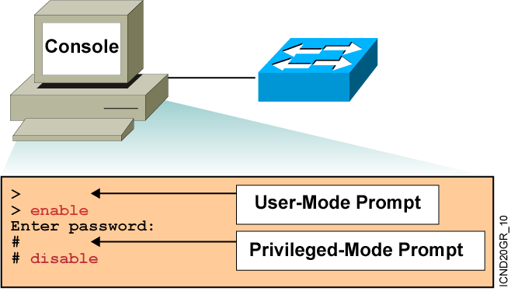
Logging In to the Switch and Entering the Enable Password
Notes:
Purpose: This slide describes logging in the Catalyst 1900 switch.
Emphasize: Earlier you presented an introduction to the two primary EXEC modes with the slides on Cisco IOS user interface fundamentals. Now teach your students about the specifics of the user mode and privileged mode on the Catalyst switch.
Note: The default prompt on the Catalyst 1900 switch is “>” and “#”, without the word “switch” in front of the prompt.
Transition: An overview of the three major types of switch command-line help facilities.

Slide 37
Switch Command-Line Help Facilities
Context-Sensitive Help
Console Error Messages
Provides a list of commands and the arguments associated with a specific command
Identifies problems with any switch commands that are incorrectly entered so that you can alter or correct them
Command History Buffer
Allows recall of long or complex commands or entries for reentry, review, or correction
Notes:
Purpose: This slide describes the Help facilities on the Catalyst 1900 switch.
Emphasize: After showing how to log in to the Catalyst 1900 Cisco IOS CLI and enabled EXEC privileged mode, use this slide to present the three main types of command-line help available.
This list is similar to, but not as extensive as the types of command-line help on the router that you present later with a similar slide.
If at this point you can demonstrate what you are presenting, so much the better.
The help on the switch is very similar to the help on the router, so the details are only presented once, in the router section.

Slide 38

Configuring the Switch
Configuration Modes:
Global configuration mode
wg_sw_a#configure terminal
wg_sw_a(config)#
Interface configuration mode
wg_sw_a(config)#interface e0/1
wg_sw_a(config-if)#
Notes:
Purpose: This slide describes the configuration modes on the Catalyst 1900 switch.
Emphasize: The Catalyst 1900 Cisco IOS CLI has global and specific configuration modes like the router Cisco IOS CLI.

Slide 39
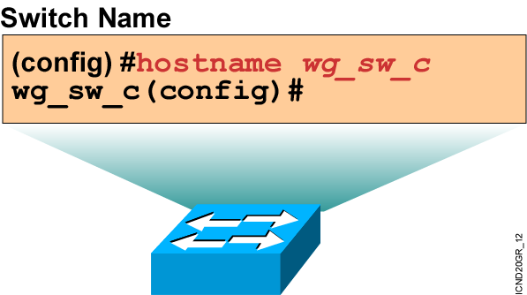
Configuring Switch Identification
Sets the local identity for the switch
Notes:
Purpose: This slide describes configuring the host name on the Catalyst 1900 switch.
Emphasize: To make configuring and maintaining a network easier, several features provide recording and descriptive information in the configuration. The first is the host name, which is simply a name by which this switch is known in the network. When you log in to a switch, the host name is displayed in the prompt. This feature is very convenient when you are remotely configuring switches, because it is a quick reminder of which switch you are accessing.
Note: The Catalyst 1900 switch has no default host name. By default, the global configuration prompt is (config)#.

Slide 40
Configuring the Switch IP Address
wg_sw_a(config)#ip address {ip address} {mask}
Example:
wg_sw_a(config)#ip address 10.5.5.11 255.255.255.0
Notes:
Purpose: This slide describes the ip address global configuration command on the Catalyst 1900 switch.
Emphasize: Why does a Layer 2 switch require an IP address? It is used for switch management purposes, for example, to Telnet to the switch, or to use the Web-based Visual Switch Manager to manage the switch.
Note: On the Catalyst 1900 and 2900xl switches, the IP address is always in VLAN1. It cannot be moved to any other VLAN like the Catalyst 5000 SC0 port.

Slide 41
Configuring the Switch Default Gateway
wg_sw_a(config)#ip default-gateway {ip address}
Example:
wg_sw_a(config)#ip default-gateway 172.20.137.1
Notes:
Purpose: This slide describes the ip address global configuration command on the Catalyst 1900 switch.
Emphasize: Why does a Layer 2 switch require an IP address? It is used for switch management purposes, for example, to Telnet to the switch, or to use the Web-based Visual Switch Manager to manage the switch.
Note: On the Catalyst 1900 and 2900xl switches, the IP address is always in VLAN1. It cannot be moved to any other VLAN like the Catalyst 5000 SC0 port.

Slide 42
Showing Switch Initial Startup Status
wg_sw_a#show version
Displays the configuration of the system hardware, software version, names and sources of configuration files, and boot images
wg_sw_a#show running-configuration
Displays the switch’s current active configuration file
wg_sw_a#show interfaces
Displays statistics for all interfaces configured on the switch
wg_sw_a#show ip
Displays the IP address, subnet mask, and default gateway
Notes:
Purpose: This slide describes three basic show commands on the Catalyst 1900 switch.
Emphasize: The next few slides will show the outputs of these show commands.

Slide 43
Switch show version Command
wg_sw_a#show version
Cisco Catalyst 1900/2820 Enterprise Edition Software
Version V8.01.01 written from 171.068.229.225
Copyright (c) Cisco Systems, Inc. 1993-2001
wg_sw_c uptime is 15day(s) 21hour(s) 53minute(s) 11second(s)
cisco Catalyst 1900 (486sxl) processor with 2048K/1024K bytes of memory
Hardware board revision is 5
Upgrade Status: No upgrade currently in progress.
Config File Status: No configuration upload/download is in progress
27 Fixed Ethernet/IEEE 802.3 interface(s)
Base Ethernet Address: 00-50-BD-73-E2-C0
Notes:
Purpose: This slide describes the show version command output on the Catalyst 1924 switch.
The 1924 has 27 fixed ports (24 10BaseT, 1 AUI, 2 100BaseT).
Emphasize: Point out that this command is useful when troubleshooting problems because it gives the versions of the Cisco IOS software. It also displays how long the switch has been in operation.
Note: The MAC address on each port is based on the base Ethernet address. For example, from this slide, the first port (e0/1) on the switch will have a MAC address of 00-50-BD-73-E2-C1.

Slide 44
Switch show interfaces Command
wg_sw_a#show interfaces ethernet 0/1
Ethernet 0/1 is Enabled
Hardware is Built-in 10Base-T
Address is 0050.BD73.E2C1
MTU 1500 bytes, BW 10000 Kbits
802.1d STP State: Forwarding Forward Transitions: 1
Port monitoring: Disabled
Unknown unicast flooding: Enabled
Unregistered multicast flooding: Enabled
Description:
Duplex setting: Half duplex
Back pressure: Disabled
--More--
Notes:
Purpose: This slide describes the show interfaces command output on the Catalyst 1900 switch.
Emphasize: The top line of the output tells us that the interface is enabled (active state). Other states are disabled (inactive state, must be manually return to the active state), or suspended (inactive state, will automatically return to the enabled state when conditions causing the suspension are removed; for example, a port security violation error can cause a port to go to the suspended state).
Note: The slide only shows the beginning portion of the show interfaces output.

Slide 45
Showing the Switch IP Address
wg_sw_c#show ip
IP Address: 10.5.5.11
Subnet Mask: 255.255.255.0
Default Gateway: 10.5.5.3
Management VLAN: 1
Domain name:
Name server 1: 0.0.0.0
Name server 2: 0.0.0.0
HTTP server : Enabled
HTTP port : 80
RIP : Enabled
wg_sw_a#
Notes:
Purpose: This slide describes the show ip command output on the Catalyst 1900 switch.
Note: RIP-enabled means the Catalyst 1900 switch will listen to the RIP updates so it can learn the default gateway IP address automatically. This is enabled by default. To disable this feature, use the no rip global configuration command.

Slide 46
Showing the Switch IP Address
Catalyst 1900
wg_sw_1900#show ip
IP address: 10.5.5.11
Subnet mask: 255.255.255.0
Default gateway: 10.5.5.3
Management VLAN: 1
…
wg_sw_a#
Catalyst 2950
wg_sw_2950#show interface vlan 1
Vlan1 is up, line protocol is up
Hardware is Cat5k Virtual Ethernet, address is 0010.f6a9.9800 (bia 0010.f6a9.9800)
Internet address is 172.16.80.79/24
Broadcast address is 255.255.255.255
. . .
wg_sw_2950#
Notes:
Note: The command to set the DNS server address is as follows:
wg_sw_a(config)#ip name-server ?
A.B.C.D IP Address

Slide 47
Catalyst 1900 and 2950 Default Configuration
IP address: 0.0.0.0
CDP: enabled
100baseT port: autonegotiate duplex mode
Spanning tree: enabled
Console password: none
Notes:
Emphasize: The Catalyst 1900 comes with a factory default setting. Listed in the slide are just some of the default settings on the switch. A switch is plug-and-play to use for basic bridging functions.

Slide 48
Configuring the Switch IP Address
Catalyst 1900
wg_sw_1900(config)#ip address {ip_address} {mask}
Configures an IP address and subnet mask on the switch
wg_sw_1900(config)#ip address 10.5.5.11 255.255.255.0
Catalyst 2950
wg_sw_2950(config-if)#ip address {ip_address} {mask}
Configures an IP address and subnet mask for the switch VLAN1 interface
wg_sw_2950(config)#interface vlan 1
wg_sw_2950(config-if)#ip address 10.5.5.11 255.255.255.0
Notes:
Layer 2 of 2
Emphasize: Explain to the students why a Layer 2 switch requires an IP address.

Slide 49
Configuring the Switch Default Gateway
wg_sw_a(config)# ip default-gateway {ip address}
Configures the switch default gateway for the Catalyst 1900 and 2950 switches
wg_sw_a(config)#ip default-gateway 10.5.5.3
Notes:
Layer 2 of 2
Note: By default, RIP is enabled on the Catalyst 1900 switch. This enables the switch to automatically learn the default gateway IP address by listening to the RIP updates.
To disable this feature, the command is as follows:
wg_sw_a(config)#no rip
wg_sw_a(config)#end
wg_sw_a#sh ip
IP Address: 10.1.1.10
Subnet Mask: 255.255.255.0
Default Gateway: 0.0.0.0
Management VLAN: 1
Domain name:
Name server 1: 0.0.0.0
Name server 2: 0.0.0.0
HTTP server : Enabled
HTTP port : 80
RIP : Disabled

Slide 50
Showing the Switch IP Address
Catalyst 1900
wg_sw_1900#show ip
IP address: 10.5.5.11
Subnet mask: 255.255.255.0
Default gateway: 10.5.5.3
Management VLAN: 1
…
wg_sw_a#
Catalyst 2950
wg_sw_2950#show interface vlan 1
Vlan1 is up, line protocol is up
Hardware is Cat5k Virtual Ethernet, address is 0010.f6a9.9800 (bia 0010.f6a9.9800)
Internet address is 172.16.80.79/24
Broadcast address is 255.255.255.255
. . .
wg_sw_2950#
Notes:
Note: The command to set the DNS server address is as follows:
wg_sw_a(config)#ip name-server ?
A.B.C.D IP Address

Slide 51
Initial Switch Configuration
There are multiple options available to configure and manage a Cisco LAN switch. These options include:
Cisco IOS Command Line Interface (CLI)
Cisco Network Assistant
Cisco Device Manager
Cisco View Management Software
SNMP Network Management Products
Some of these options use IP connectivity or a web-browser to connect to the switch, this requires the use of an IP address.
Unlike router interfaces, switch ports are not assigned IP addresses.
In order to use an IP-based management product or Telnet session to manage a Cisco switch, it is necessary to configure a management IP address on the switch.
Once the management IP address is assigned, these tools can use that IP address to access the switch.
Until this address is assigned, it is necessary to connect directly to the console port and use a terminal emulation program to perform configuration tasks.

Slide 52
Cont…
The Cisco Catalyst 2960 switch comes preconfigured and only needs to be assigned basic security information before being connected to the network.
The commands to configure hostname and passwords on the switch are the same commands used to configure the ISR.
In order to use an IP-based management product or Telnet with a Cisco switch, configure a management IP address.
There is one virtual local network, VLAN 1, preconfigured in the switch to provide access to management functions.
To configure the IP address assigned to the management interface on VLAN 1, enter global configuration mode

Slide 53
Cont…
Switch>enable
Switch#configure terminal
Next, enter the interface configuration mode for VLAN 1.
Switch(config)#interface vlan 1
Set the IP address, subnet mask and default gateway for the management interface.
The IP address must be valid for the local network where the switch is installed.
Switch(config-if)#ip address 192.168.1.2 255.255.255.0
Switch(config-if)#exit
Switch(config)#ip default-gateway 192.168.1.1
Switch(config)#end
Save the configuration by using the copy running-configuration startup-configuration command.

Slide 54
Connect the Switch to the Network
To connect the switch to a router, use a straight-through cables.
LED lights on the switch and router indicate that the connection is successful.
Once the switch and router are connected, determine if the two devices are able to exchange messages.
1. Check the IP address configuration
Use the show running-configuration command to verify that the IP address of the management interface on the switch VLAN 1, and the IP address of the directly connected router interface are on the same local network.

Slide 55
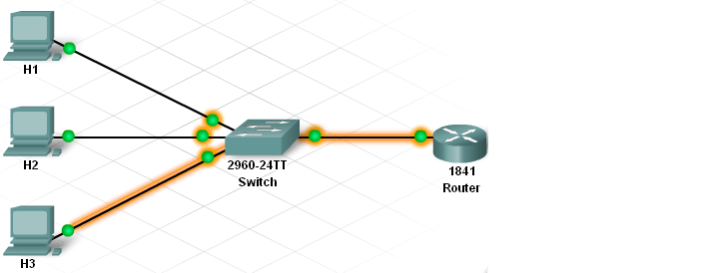
Use the ping command to test the connection.
From the command line interface on the switch, ping the IP address of the directly-connected router interface.
Repeat the process from the command line interface on the router by pinging the management interface IP address assigned to the switch VLAN 1.
If the ping is not successful, verify the connections and configurations again.
Check to ensure that all cables are correct and that connections are seated.
After the switch and router are successfully communicating, connect the individual PCs to the switch using straight-through cables.
Access layer switch ports are accessible through the structured cabling at wall outlets.
This is a potential entry point to the network by unauthorized users. Switches provide a feature called port security.
It is possible to limit the number of addresses that can be learned on an interface.
If the number of MAC addresses per port is limited to 1, the first address dynamically learned by the switch becomes the secure address.

Slide 56
CDP(Cisco Discovery Protocol)
Cisco Discovery Protocol (CDP) is an information-gathering tool used on a switch, router to share information with other directly connected Cisco devices.
By default, CDP begins running when the device boots up. It then sends periodic messages, known as CDP advertisements, onto its directly connected networks.
CDP operates at Layer 2 only and can be used on many different types of local networks, including Ethernet and serial networks.
Because it is a Layer 2 protocol, it can be used to determine the status of a directly connected link when no IP address has been configured, or if the IP address is incorrect.
Two Cisco devices that are directly connected on the same local network are referred to as being neighbors.
The concept of neighbor devices is important to understand when interpreting the output of CDP commands.
Information gathered by CDP includes:
Device identifiers - configured host name
Address list - Layer 3 address, if configured
Port identifier - directly connected port, for example: serial 0/0/0
Capabilities list - function or functions provided by the device
Platform - hardware platform of the device, for example Cisco 1841

Slide 57
Cont…
The outputs from the show cdp neighbors and show cdp neighbors detail commands display the information that a Cisco device collects from its directly connected neighbors.
Viewing CDP information does not require the user to log into the remote devices.
Because CDP collects and displays a lot of information about directly connected neighbors, without requiring a login to those neighbors, it is usually disabled in production networks.

Slide 58
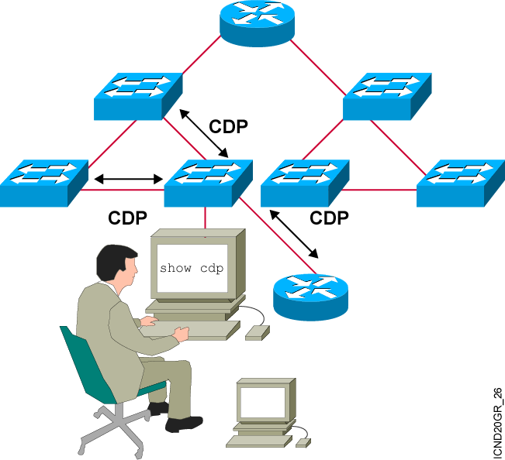
Discovering Neighbors with CDP
CDP runs on routers with Cisco IOS® software Release 10.3 or later and on Cisco switches and hubs.
Summary information includes:
Device identifiers
Address list
Port identifier
Capabilities list
Platform
Notes:
Emphasize: CDP is media- and protocol-independent and runs on all Cisco-manufactured equipment including routers, access servers, switches, and some managed hubs. With CDP, network management applications can retrieve the device type and SNMP agent address of neighboring devices. This capability enables applications to send SNMP queries to neighboring devices.
CDP allows network management applications to dynamically discover Cisco devices that are neighbors. CDP runs on all media that support the Subnetwork Access Protocol, including LAN and Frame Relay. CDP runs over the data link layer only, not the network layer. Therefore, two systems that support different network-layer protocols can learn about each other.
Cached CDP information is available to network management applications. Cisco devices never forward a CDP packet. When new information is received, old information is discarded. The holdtime determines how long to keep existing information from a neighbor.

Slide 59
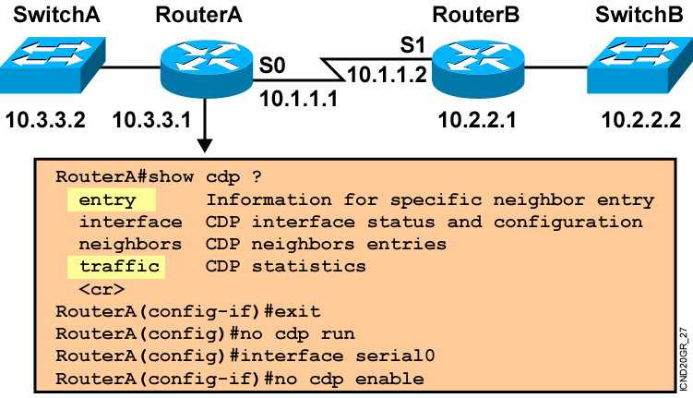
Using CDP
Notes:
Note: Some of the CDP commands are not available on the Catalyst 1900 switch, like cdp run, show cdp traffic, and show cdp entry.

Slide 60
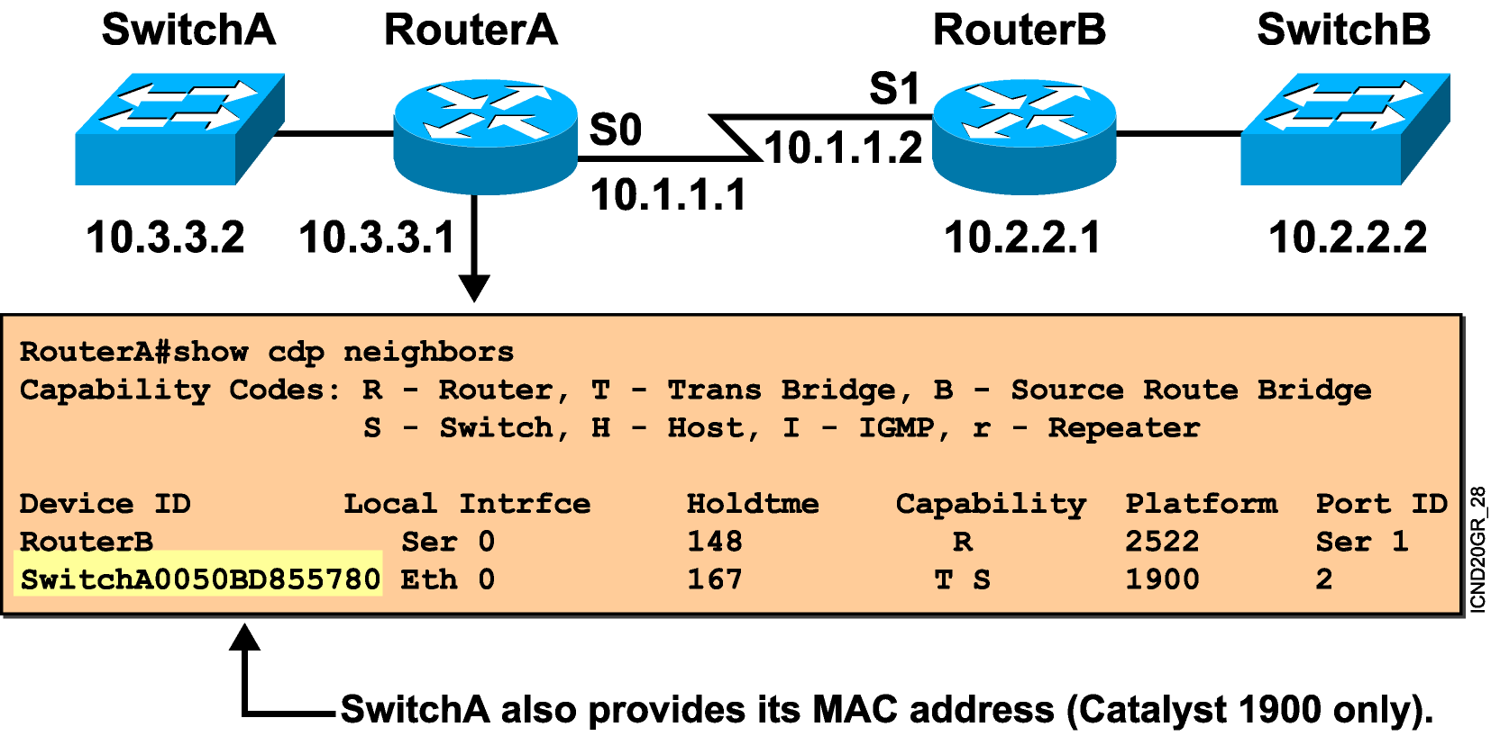
Using the show cdp neighbors Command
Notes:
Emphasize: This graphic shows the show cdp neighbors command initiated from a router, which displays a summary of the capabilities and access details for the CDP neighbors. The show cdp neighbors detail command shows detailed information about the same devices.
Note: If the neighbor is a Catalyst 1900 switch, the switch MAC address is also displayed. If the switch is a 2900xl, its MAC address is not displayed.

Slide 61
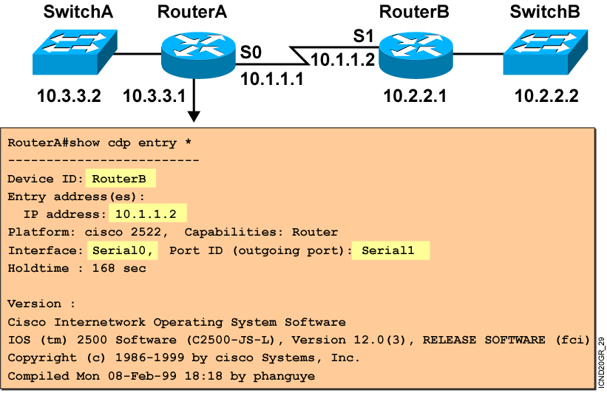
Using the show cdp entry Command
Notes:
Emphasize: The example shows what information can be obtained about RouterA’s neighbor. CDP is one way to learn about other Cisco devices on the network.

Slide 62
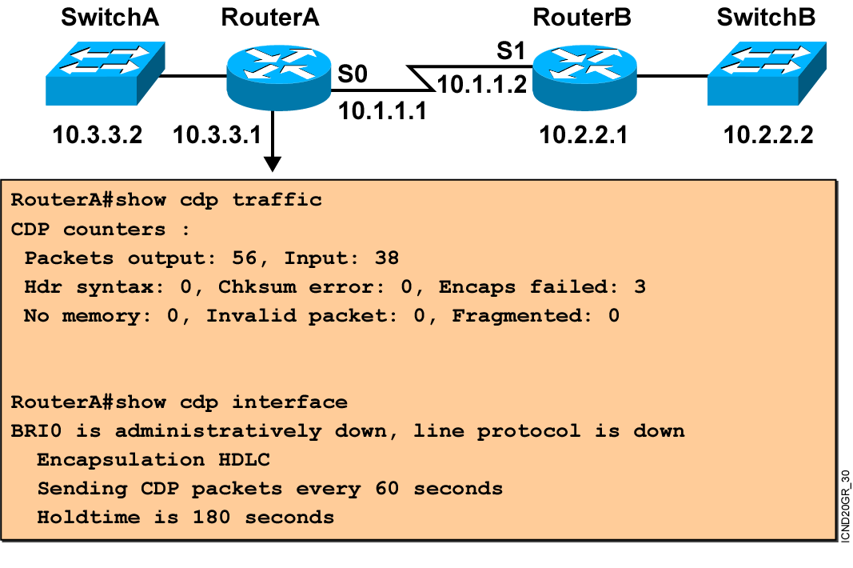
Additional CDP Commands
Notes:
Note: The holdtime indicates how long the neighbor information will be kept in the local CDP table.

Slide 63
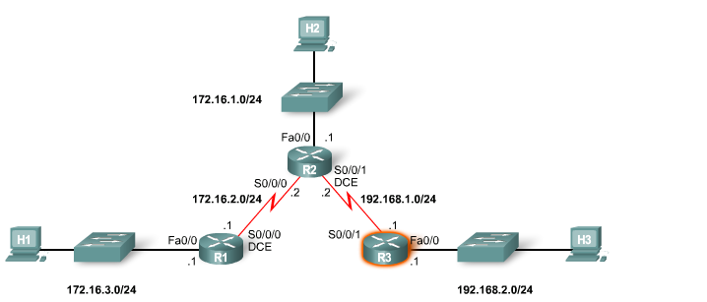
Cont…

Slide 64
Installing the CPE(customer premise equipment)
One of the main responsibilities of an on-site network technician is to install and upgrade equipment located at the customer's home or business.
Network devices installed at the customer location are called customer premise equipment (CPE).
Before any equipment is installed at the customer site, the devices are configured and tested at the ISP site.
Anything that is not functioning as expected can be replaced or fixed immediately.
The network technician makes sure the router is fully configured and that the router configuration is verified. The router is then repackaged for shipment or delivery to the customer.
Once the router is known to be configured correctly, all network cables, power cables, management cables, manufacturer documentation, manufacturer software, configuration documentation and the special tools needed for router installation are assembled.

Slide 65
Cont…
An inventory checklist is used to verify that all necessary equipment needed to install the router is present.
Usually the network technician signs the checklist, indicating that everything has been verified.
The signed and dated inventory checklist is included with the router when it is packaged for shipping to the customer premise.
The installation of a new router can be disruptive for a business.
Many businesses rely on the Internet for their business correspondence and often have e-commerce services that must be accessed during the day.
It may be impossible to install or upgrade network equipment during normal business hours.
If the installation of the new equipment will cause the network to be down, the network technician, the ISP sales person and a representative of the company prepare a router installation plan.
This plan ensures that the customer will experience a minimum of disruption in service while the new equipment is installed.

Slide 66
Connecting to a Device at the Remote
After a new network device is installed at the customer premise, it must be monitored from the remote ISP location.
Telnet
Telnet can be used over an IP network connection to connect to a device to monitoring and administering it.
Telnet is not a secure protocol.
Telnet sends all the information between the PC and the device in a clear text format.
The username and password used to authenticate the device can easily be discovered.

Slide 67
Cont…
Use port 23 and virtual interface
By default telnet s disable
The router should have secret password
wsu2(config)#enable secret 123.com
wsu2(config)#line vty 0 4
wsu2(config-line)#password cs.com
wsu2(config-line)#login
To access remote device in command prompt type
Pc>telnet [remote device IP address]

Slide 68
Cont…
SSH
SSH protects all authentication and transmitted data using encryption(RSA).
SSH allows safe access a remote device over an insecure network, such as the Internet.
It use port 22
When we enable RSA algorithm it generate two key, public and private key.
Public key:- Used to encrypt information
Private key:- used to decrypt information

Slide 69
Cont…
Each router have both public and private key.
Steps to configure SSH
Change Hostname( public and private key generate based on hostname) and Hostname should be d/f.
Configure Domain Name.
Create user name and password
Generate RSA key(size 512 or 1024 or 1048).
Configure line vty for SSh

Slide 70
Cont…
wsu-router(config)#hostname it
it(config)#ip domain-name it.com
it(config)#username it privilege 15 secret 123.com
it(config)#crypto key generate rsa
How many bits in the modulus [512]: 512
it(config)#line vty 0 4
it(config-line)#login local
it(config-line)#transport input ssh
To access remote device
Pc>ssh –l username IP address

Slide 71
Traffic Filtering
It is important to prevent access by unauthorized users and protect the network from various attacks, such as DoS (Denial –of -Service) attacks.
Unauthorized users can modify, destroy, or steal sensitive data on servers.
DoS attacks prevent valid users from accessing facilities.
Through traffic filtering, an administrator controls traffic in various segments of the network.
Filtering is the process of analyzing the contents of a packet to determine if the packet should be allowed or blocked.

Slide 72
Cont…
Packet filtering can be simple or complex, denying or permitting traffic based on:
Source IP address
Destination IP address
MAC addresses
Protocols
Application type
One of the most common methods of traffic filtering is the use of access control lists (ACLs).
ACLs can be used to manage and filter traffic that enters a network, as well as traffic that exits a network.
The primary use of ACLs is to identify the types of packets to accept or deny.

Slide 73
Types of ACL
1. Standard ACLs
The Standard ACL is the simplest of the three types. When creating a standard ACL, the ACLs filter based on the source IP address of a packet.
If a host device is denied by a standard ACL, all services from that host are denied.
Standard ACLs are identified by the number assigned to them.
For Standard access lists, the identification number can range from 1 to 99 and from 1300 to 1999.
Router(config)#access-list 1 permit host 172.16.2.88
Permits a specific IP address

Slide 74
Cont…
2. Extended ACLs
Extended ACLs filter not only on the source IP address but also on the destination IP address, protocol, and port numbers.
Extended ACLs are used more than Standard ACLs because they are more specific and provide greater control.
The range of numbers for Extended ACLs is from 100 to 199 and from 2000 to 2699.
Router(config)#access-list 100 deny tcp 172.16.2.0 0.0.0.255 any eq telnet
Denies access from the 172.16.2.0/24 subnet to any other host if they are attempting to use telnet

Slide 75
Cont…
3. Named ACLs
Named ACLs (NACLs) are either Standard or Extended format that are referenced by a descriptive name rather than a number.
When configuring named ACLs, the router IOS uses a NACL subcommand mode.
Router(config)#ip access-list standard permit-ip
Router(config-ext-nacl)#permit host 192.168.5.47
Creates a standard access list named permit-ip
Allows access from IP address 192.168.5.47

Slide 76
The End

